Slide 1
Name
Institution
Date
Healthcare

Slide 2
Synopsis
Transgender children are those children whose gender identity/gender expression differs from their assigned sex at birth.
Transgender children desiring medical assistance so as to transition from one sex to another identity are referred to as transsexual.
Transgender children face a lot of challenges compared to transgender adults which is ethically justifiable. This is because transgender children only depend on their parents for many things including care, shelter, and financial support which is in line with the principle of right to open future (ROFT)
In addition, transgender children face reluctant from doctors to provide them with medical treatments.
Notes:
The issues of transgender manifest at different times in life in different individuals.
Transgender children often experience rejection due to their differences.

Slide 3

The youngest transgender child in the world video

Slide 4
Meet My Transgender Kid- Isabelle’s Story

Slide 5

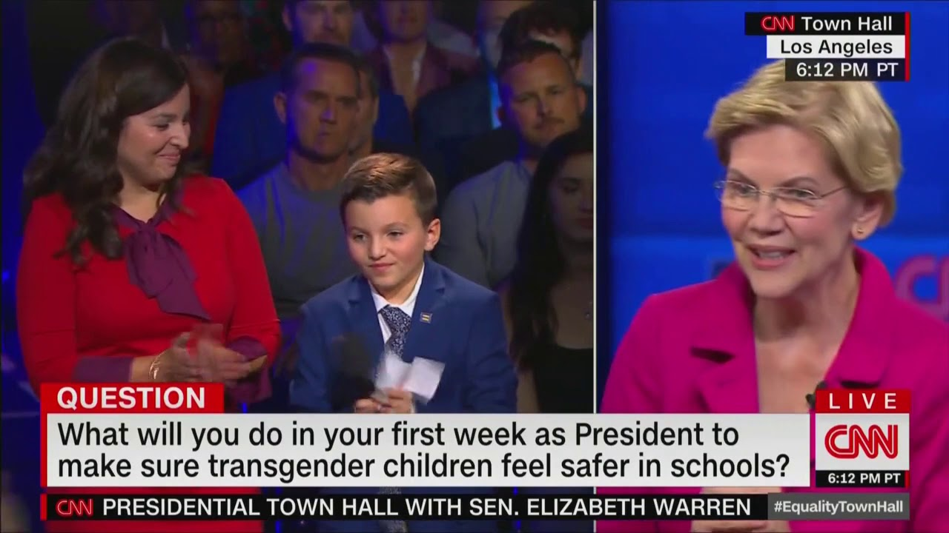

Slide 6
Ethical Questions
Should transgender children be subjected to counseling at an early age so as to accept their assigned gender at birth?
Do society treat transgender children equally after transitioning?
Is it advisable for transgender children to change their official records after transitioning?
Does the society promote the rights of transgender children?

Slide 7
Continuation…
Is the society accepting the increasing number of transgender children?

Slide 8
Ethical Analysis
The systematic approach to figuring out the moral decision which is right in a particular situation is what is referred to as ethical analysis.
In this case of transgender in children, using the ethical code to analyze the situation logically can guarantee the best option which is both effective and moral.
In this way, an accurate picture of the situation will be formed as the decision making will be effective.
The society will be get back on track and transgender children will be treated equally.
In this way autonomy will be taken to their own hands as different strategies will be applied in different societies to ensure equality.

Slide 9
Continuation…
The ethical analysis of transgender children will follow this steps below;
Gathering the facts
Defining the involved ethical issue
Identification of involved parties
Outlining solution which are potential and the possible consequences
Picking the most appropriate ethical action to follow.

Slide 10
Recommendation
The recommendation I would advocate is ensuring transgender children receive comprehensive care and support.
This population has been traditionally being underserved and faces numerous health disparities.
There is therefore an urgent need to treatment which is standardized, more formal training so that health and positive development of transgender children leading to stigma and discrimination eliminated.
During treatment, a maximum benefit for these transgender can be achieved by ensuring non-maleficence.
Also enough research should be done to look into how the ethical posed questions and challenges can be addressed. However, the researchers should be beneficence to the research participants who will particularly be transgender children.(Nealy, 2017)

Slide 11
References
Nealy, E. C. (2017). Transgender children and youth: Cultivating pride and joy with families in transition.
Gill-Peterson, J. (2018). Histories of the transgender child.
https://www.youtube.com/watch?v=6nR16HZ5rEg
https://www.youtube.com/watch?v=AnYOe9CTnzo
https://www.washingtonexaminer.com/news/warren-applauds-9-year-old-transgender-child-at-cnn-forum

